Slide 1
IoT시스템
5주차 과제
반 YA 학번: 20202296
이름: 전채린

Slide 2
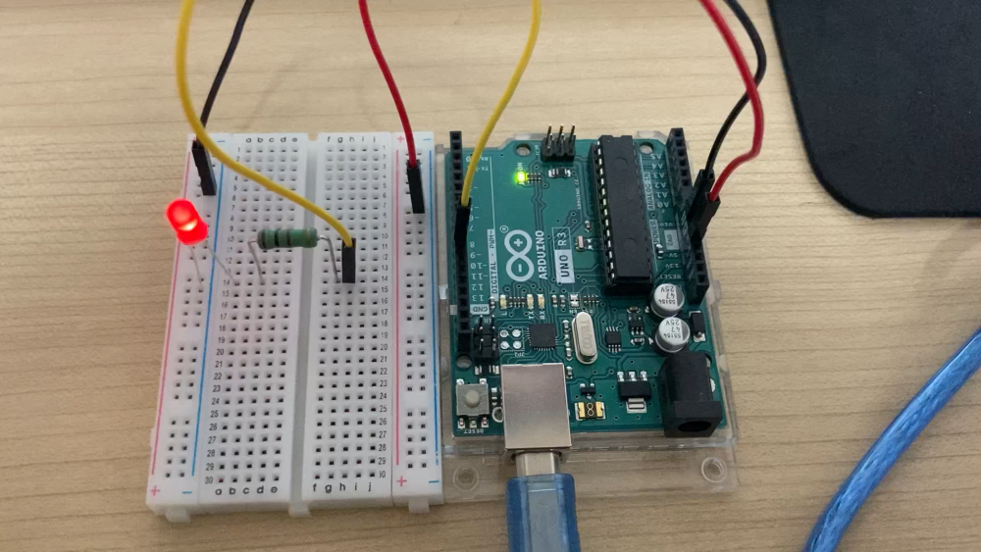
실습1 동작 영상

Slide 3
실습1 스케치
int led = 9; // the pin that the LED is attached to
int brightness = 0; // how bright the LED is
int fadeAmount = 5; // how many points to fade the LED by
void setup() {
pinMode(led, OUTPUT);
}
void loop() {
analogWrite(led, brightness);
brightness = brightness + fadeAmount;
if(brightness == 255) {
brightness = 0;
}
delay(30);
}

Slide 4
실습2 스케치
int led = 9; // the pin that the LED is attached to
int fadeAmount = 5; // how many points to fade the LED by
void setup() {
pinMode(led, OUTPUT);
}
void loop() {
for(int brightness = 0; brightness < 255; brightness += fadeAmount ) {
analogWrite(led, brightness);
delay(30);
}

Slide 5
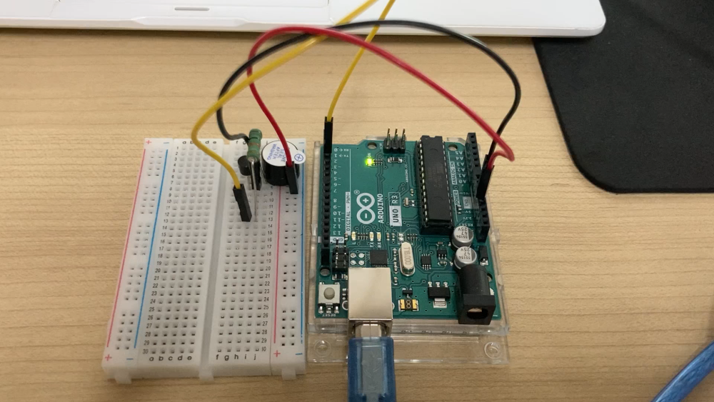
실습3 동작 영상

Slide 6
실습3 스케치
int speakerPin = 3;
void setup() {
}
void loop() {
tone(speakerPin, 392);
delay(500);
tone(speakerPin, 392);
delay(500);
tone(speakerPin, 440);
delay(500);
tone(speakerPin, 440);
delay(500);
tone(speakerPin, 392);
delay(500);
tone(speakerPin, 392);
delay(500);
tone(speakerPin, 330);
delay(1000);
tone(speakerPin, 392);
delay(500);
tone(speakerPin, 392);
delay(500);
tone(speakerPin, 330);
delay(500);
tone(speakerPin, 330);
delay(500);
tone(speakerPin, 294);
delay(1500);
noTone(speakerPin);
delay(500);
tone(speakerPin, 392);
delay(500);
tone(speakerPin, 392);
delay(500);
tone(speakerPin, 440);
delay(500);
tone(speakerPin, 440);
delay(500);
tone(speakerPin, 392);
delay(500);
tone(speakerPin, 392);
delay(500);
tone(speakerPin, 330);
delay(1000);
tone(speakerPin, 392);
delay(500);
tone(speakerPin, 330);
delay(500);
tone(speakerPin, 294);
delay(500);
tone(speakerPin, 330);
delay(500);
tone(speakerPin, 262);
delay(1500);
noTone(speakerPin);
delay(500);
}

Slide 7
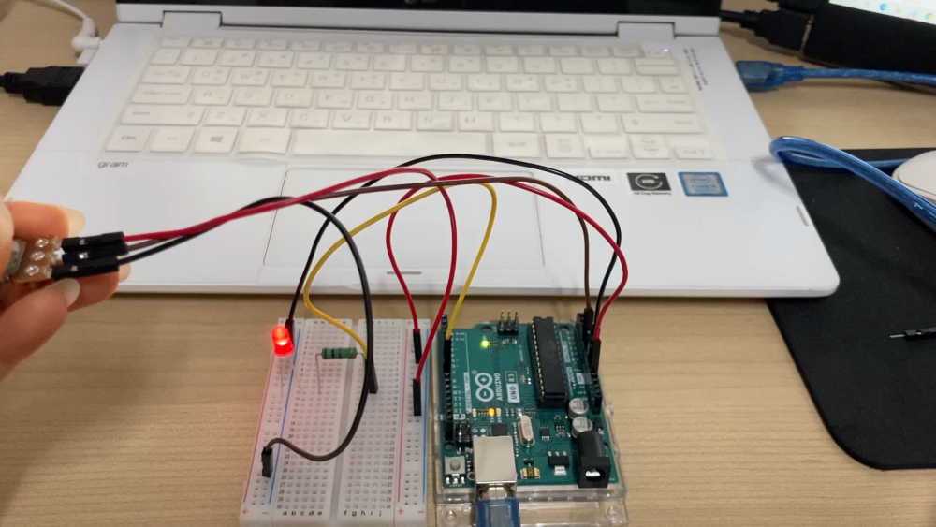
실습6 동작 영상

Slide 8
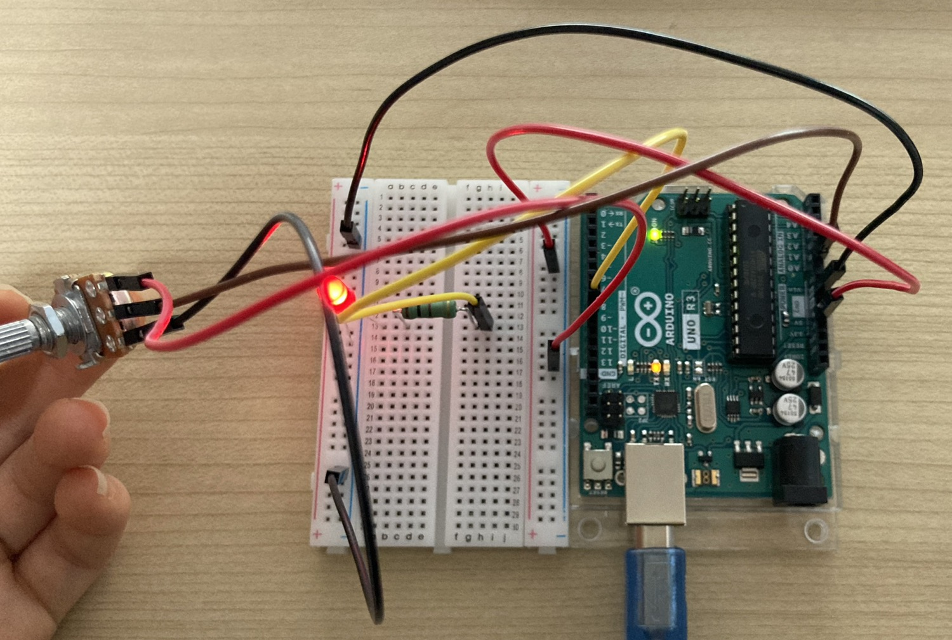
실습6 회로 구성 사진

Slide 9
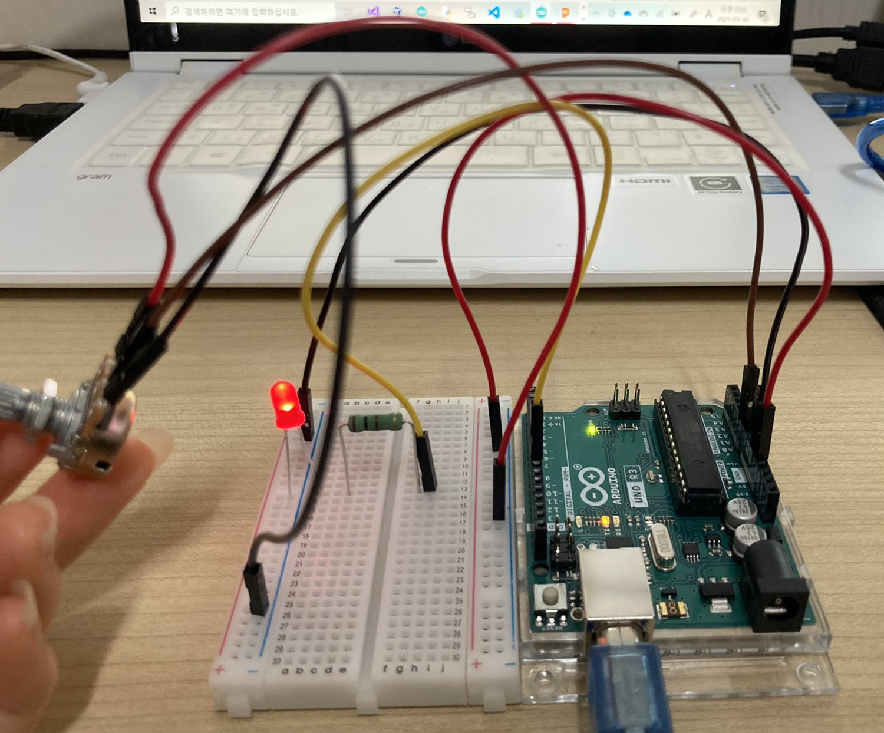
실습6 회로 구성 사진

Slide 10
실습6 스케치
int sensorPin = A0; //select the input pin for the potentiometer
int led = 9; // the pin that the LED is attached to
void setup() {
pinMode(led, OUTPUT);
Serial.begin(9600);
}
void loop() {
int sensorValue = 0;
float voltage = 0.0;
sensorValue = analogRead(sensorPin);
voltage = ((float)sensorValue/1023.0)*5.0;
Serial.print(sensorValue);
Serial.print(", ");
Serial.println(voltage);
analogWrite(led, sensorValue/4);
delay(10);
}

